Slide 1
Particle Swarm optimization
By Srikar Maddala

Slide 2
INTRODUCTION
Particle Swarm Optimization (PSO) is a population-based stochastic search algorithm/ problem solving technique inspired by swarming behavior for example a flock of birds or a colony of ants. It imagines solutions as particles that move through a search space, influenced by their own best position and the best position found by the entire swarm. This guides them towards optimal solutions.
Unlike some methods, PSO doesn't need intricate problem details and works well in large search spaces. However, it doesn't guarantee the absolute best solution. It's a good choice when finding a very good solution quickly is more important than the absolute optimum.

Slide 3


A Swarm-Inspired Optimization Technique
Particle Swarm Optimization(PSO) mimics the social behavior of bird flocks, where individuals adjust their flight paths based on their own experiences and the experiences of others in the flock. This collective intelligence allows the flock to efficiently search for food, avoid predators, and navigate complex environments.
. Here's how PSO borrows from these principles:
Social Interaction: Birds in a flock communicate with each other through visual cues, vocalizations, and other forms of signaling in the same topology. This information exchange helps them to coordinate their movements and make collective decisions.
Individual learning:Each bird learns from its own experiences, exploring the environment and adjusting its behavior based on the feedback it receives.
Collective Exploration: Through this interplay, the swarm of particles iteratively explores the search space, converging towards increasingly optimal solutions. This mirrors the swarm's ability to efficiently locate the best food sources.

Slide 4
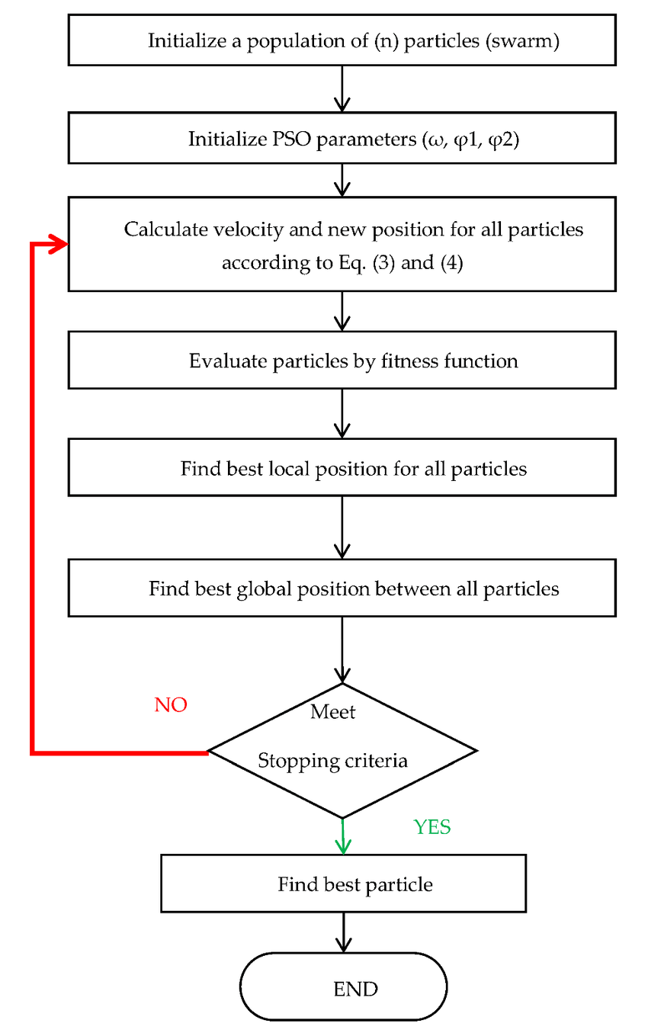
Algorithm
Initialization:
Define the problem space and objective function to be optimized.
Create a swarm of particles, each representing a potential solution.
Assign each particle a random position and velocity within the search space.
Iteration:
Evaluate Fitness: Calculate the fitness (objective function value) for each particle.
Update Personal Best: For each particle, compare its current fitness to its personal best fitness encountered so far. If the current fitness is better, update the particle's personal best position and fitness value.
Update Global Best: Identify the particle with the best fitness value across the entire swarm. This becomes the global best position.
Update Velocity: For each particle, calculate a new velocity based on:
Its current velocity.
A random weighting factor.
The difference between its current position and its personal best position.
The difference between its current position and the global best position.
Movement: Update the position of each particle based on its new velocity.
Termination: Repeat steps 2-5 for a predetermined number of iterations or until a satisfactory solution is found.

Slide 5
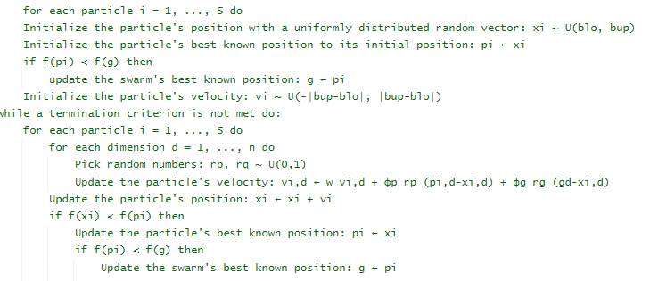
Pseudo Code
Inertia weight
Cognitive coefficient
Social coefficient

Slide 6
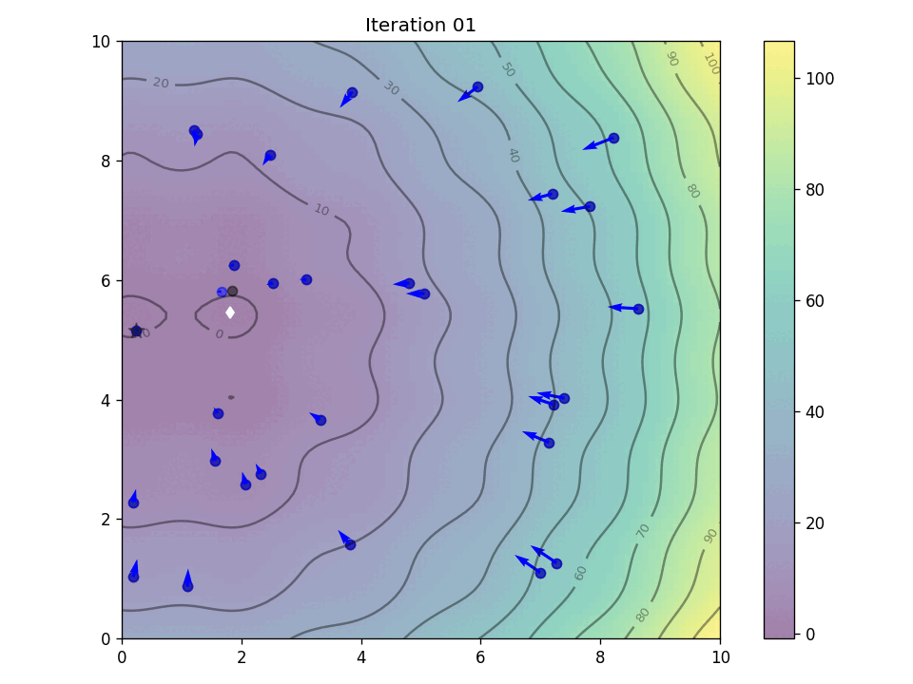
Finding MINIMA
Finding the deepest point in a vast, uneven cave can be slow if you check every single crevice. Just throwing rocks in random directions might eventually find a deep spot, but if finding a deeper hole makes finding even deeper ones nearby more likely, there's a better approach.
Particle Swarm Optimization (PSO) is like explorers searching for the bottom of a giant cave. We start with the explorers scattered randomly throughout the cave (particles). At each step, each explorer checks two locations:
The deepest point they've found so far (like an explorer remembering a particularly deep crevice).
The deepest point discovered by any member of the group (like following excited shouts of explorers who found an even deeper pit).
By following both these clues, the group eventually converges on the deepest point explored so far by any member. This trick helps PSO efficiently navigate the complex cave system and locate the absolute bottom.

Slide 7
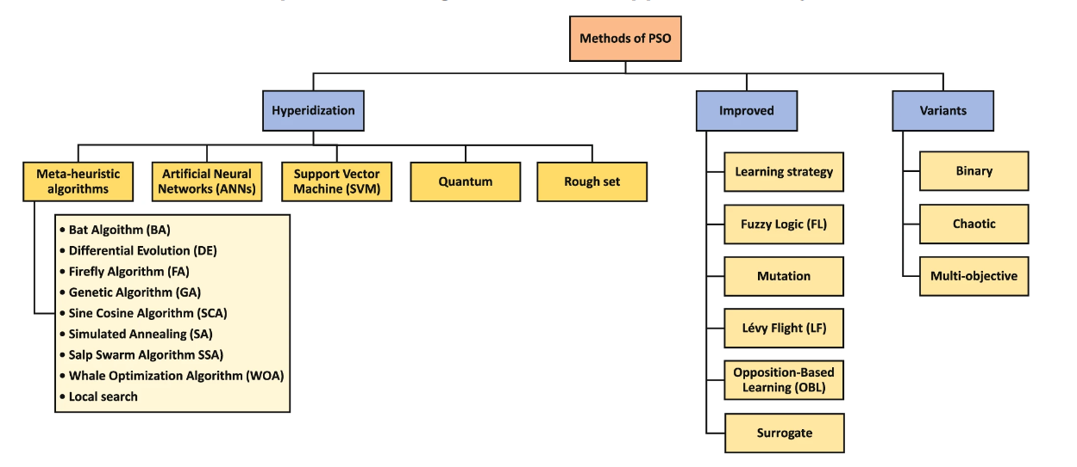
Methods of PSO

Slide 8
Advantages of PSO
PSO tackles complex problems with multiple solutions by balancing exploration and exploitation. Randomness in particle movement helps discover new areas (exploration), while information sharing guides the swarm towards promising regions found by individuals and the group (exploitation). This balance increases PSO's chances of finding the absolute best solution.
Global Optimization : PSO has the potential to find global optima, unlike some other algorithms that can get stuck in local optima.
Robustness : PSO is robust to noise and can handle problems with a large number of parameters and complex fitness landscapes.
Flexibility : PSO is flexible and can be easily adapted to different optimization problems by adjusting parameters and modifying the fitness function.

Slide 9
Challenges & Limitations
Despite its many advantages, PSO has some challenges and limitations, such as premature convergence and the need for careful parameter tuning. It is important to carefully choose the appropriate parameters for the optimization problem at hand to ensure that the algorithm converges to a good solution.
Premature Convergence: In some cases, the particles in the swarm may converge prematurely to a local optimum, preventing them from finding the global optimum.
Parameter Tuning : PSO's power hinges on fine-tuning key settings. Inertia weight controls exploration (searching new areas), while cognitive and social coefficients balance how much particles leverage their own best finds vs. the swarm's best. This tuning optimizes PSO for specific problems.
Complexity : While powerful, PSO's effectiveness can be limited in highly intricate search spaces, hindering its ability to efficiently locate optimal solutions.

Slide 10
Tackling Premature Convergence in PSO
PSO convergence refers to the swarm collectively reaching a state where all particles settle on a (potentially not guaranteed to be globally) optimal solution.
Particle Swarm Optimization (PSO) can fall victim to premature convergence, where the swarm settles on a good but not necessarily the best solution (local optimum) and ceases its search for the absolute best (global optimum). Here's a simplified explanation of the issue and some methods to address it:
Causes:
Over-reliance on Global Best: Particles heavily rely on the best solution found so far (gbest) to update their positions. If all particles converge on a local best early on, they may miss exploring other areas with the potential for a better solution.
Loss of Diversity: Over time, particles become too similar to each other, reducing the swarm's overall exploration ability.

Slide 11
Tackling Premature Convergence in PSO
Prevention Techniques:
Inertia Weight (w): This parameter controls how much a particle's past movement influences its current one. A high inertia weight encourages exploration by allowing particles to maintain momentum. Conversely, a low weight focuses on recent information from personal bests (pbest) and gbest. Common strategies include:
Decreasing Inertia Weight: Start high and gradually decrease it over time, enabling broader exploration initially and then refining the search later.
Random Inertia Weight: Introduce randomness within a defined range to add variability and prevent getting stuck in local optima.
Velocity Clamping: Limits the maximum speed of particles, preventing them from overshooting promising areas and maintaining some exploration even when influenced by gbest.
Cognitive Acceleration Coefficient (c1): This parameter controls the influence of a particle's personal best (pbest) on its movement. A slightly increased c1 value can encourage particles to explore their own promising regions more, potentially leading them to the global optimum.
By employing these techniques, we can enhance PSO's ability to navigate complex search spaces and increase the likelihood of finding the optimal solution.

Slide 12
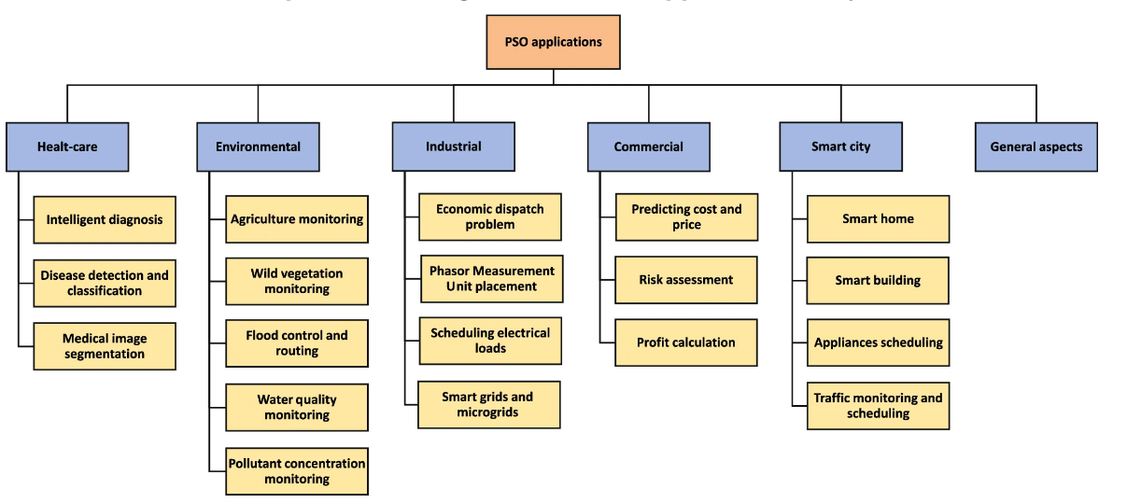
Applications of PSO

Slide 13
Future Directions in PSO Research
Research in PSO continues to explore new approaches to address its challenges and expand its capabilities. Some promising areas of research include hybrid PSO algorithms, multi-objective PSO, and the integration of PSO with deep learning techniques.
1. Hybrid PSO: Combines PSO with other algorithms, leveraging their strengths (e.g., PSO for exploration, others for exploitation) for a more robust search process.
2. Multi-Objective PSO: Develops PSO algorithms to handle problems with multiple objectives for more nuanced decision making, crucial in real-world scenarios.
3. Deep Learning Integration: Explores integrating deep learning with PSO to enhance its ability to tackle complex, high-dimensional optimization problems (e.g., using deep learning for search space representation or particle movement guidance).

Slide 14
References
Github : https://github.com/SrikarMaddala/INCOIS
Machine Learning mastery : A Gentle Introduction to Particle Swarm Optimization - MachineLearningMastery.com
Research paper : https://link.springer.com/article/10.1007/s11831-021-09694-4#Sec3
Geeksforgeeks : https://www.geeksforgeeks.org/particle-swarm-optimization-pso-an-overview/

Slide 15


